Slide 1
Selection Structures (if & switch statements)

Slide 2
Equality and Relational Operators
Equality Operators:
Operator Example Meaning
== x == y x is equal to y
!= x != y x is not equal to y
Relational Operators:
Operator Example Meaning
> x > y x is greater than y
< x < y x is less than y
>= x >= y x is greater than or equal to y
<= x <= y x is less than or equal to y

Slide 3
Logical Operators
Logical operators are useful when we want to test multiple conditions
Three types:
boolean AND
boolean OR
boolean NOT

Slide 4
Boolean AND or logical AND
Symbol: &&
All the conditions must be true for the whole expression to be true
Example:
if ( (a == 10) && (b == 10) && (d == 10) )
cout<<“a, b, and d are all equel to 10”;

Slide 5
Boolean OR / Logical OR
Symbol: ||
ANY condition is sufficient to be true for the whole expression to be true
Example:
if (a == 10 || b == 9 || d == 1)
// do something

Slide 6
Boolean NOT/ Logical NOT
Symbol: !
Reverses the meaning of the condition (makes a true condition false, OR a false condition true)
Example:
if ( ! (marks > 90) )
// do something

Slide 7
Decision Making: Equality and Relational Operators

Slide 8
Control Statements
Selection Statements
Using if and if...else
Nested if Statements
Using switch Statements
Repetition Statements
Looping: while, do-while, and for
Nested loops

Slide 9
Selection Structures
Condition
True
False
Do Step 1
Do Step 2

Slide 10
Selection Statements
There are two selections, or branch control structures:
If statements
switch structure.

Slide 11
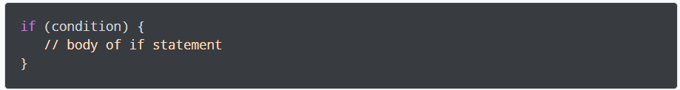
if statement (One way Selection)
The syntax of the if statement is:
The if statement evaluates the condition inside the parentheses ( ).
If the condition evaluates to true, the code inside the body of if is executed.
If the condition evaluates to false, the code inside the body of if is skipped.
Notes:
Note: The code inside { } is the body of the if statement.

Slide 12
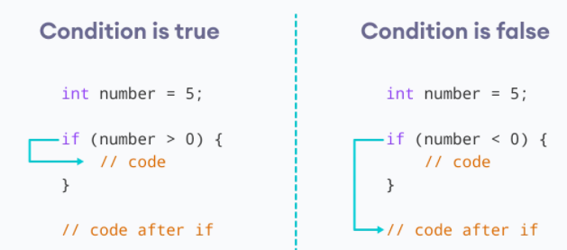
How if statement Works?

Slide 13
If statement (One Way)
- Syntax of if with single-statement body
if (expression) Decision Maker Statement Action Statement
If (Customer_balance < Minimum_Required_Balance)
Send Notice to Cutomer Single Statement
Notes:
Problem: A bank would like to send a notice to a customer if her or his checking account balance falls below the required minimum balance. That is, if the account balance is below the required minimum balance, it should send a notice to the customer; otherwise, it should do nothing.

Slide 14
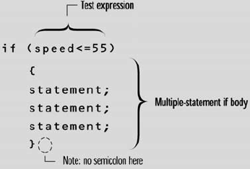
If statement (One Way)
Syntax of if with multiple-statements body
When a group of statements must be selected for execution, we enclose them between curly braces { and } to form a single statement.
A block or a compound statement:

Slide 15
Valid or Invalid???
Consider the following C++ statement:
if score >= 60 //Error
grade = 'P';
Consider the following C++ statements:
if (score >= 60); //Line 1 Error
grade = 'P'; // Line 2

Slide 16
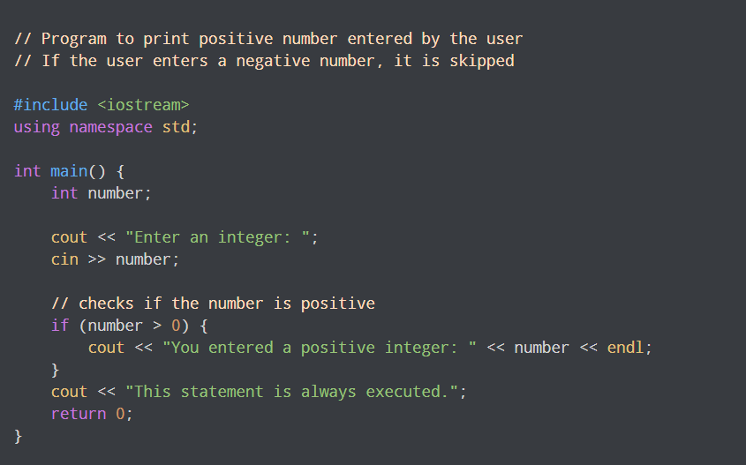
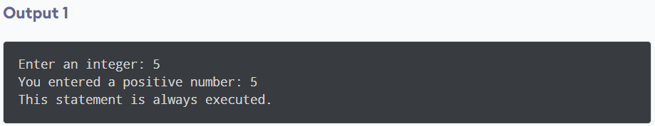
Sample of if program

Slide 17
Examples…. (if, one-way)
Examples….
Write a program to calculate tax collection according to the following formula:
5% Tax, if salary is above 50000
3% Tax , if salary is between 30000 and 50000
2% Tax, is salary is less than 30000
In the end the program should print the calculated tax.

Slide 18
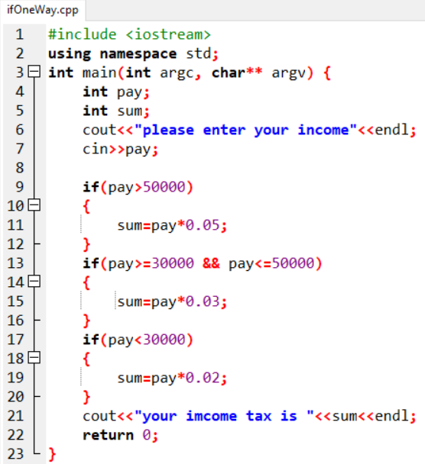

Examples…. (if, one-way)

Slide 19
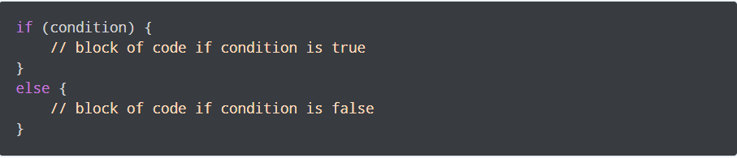
if...else statement (Two way Selection)
The if statement can have an optional else clause. Its syntax is:
If the condition evaluates true,
the code inside the body of if is executed
the code inside the body of else is skipped from execution
If the condition evaluates false,
the code inside the body of else is executed
the code inside the body of if is skipped from execution

Slide 20
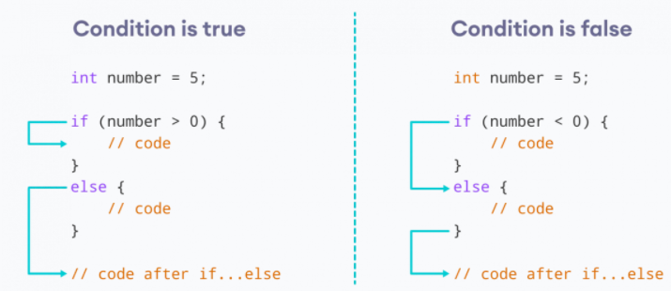
How if…else statement Works?

Slide 21
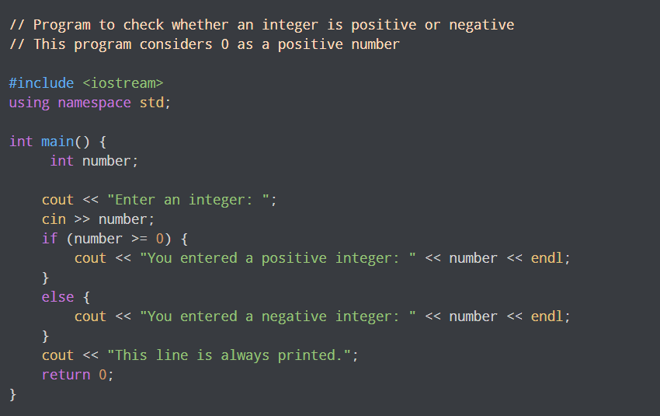
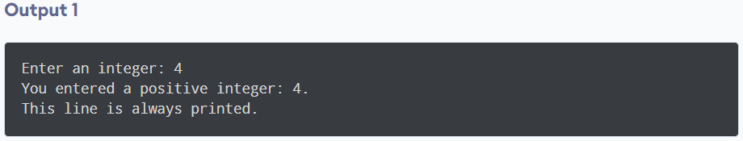
Sample of if…else program

Slide 22
Example…. (if, Two-way)
Examples….
Write a program that squares a number (entered by user), if it is between 10 and 100. For all other numbers, an Error message is shown and program terminates.

Slide 23
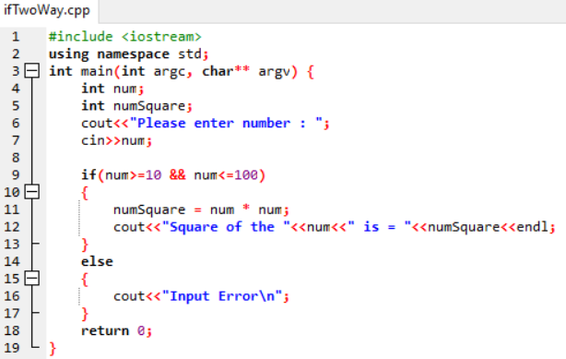
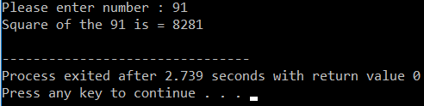
Example…. (if, Two-way)

Slide 24
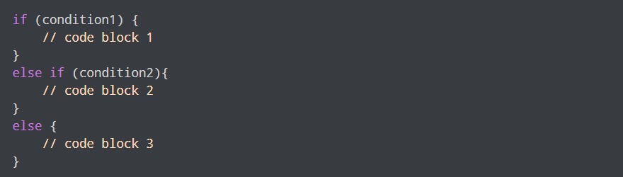
if...else...else if statement
The if...else statement is used to execute a block of code among two alternatives.
However, if we need to make a choice between more than two alternatives,
we use the if...else if...else statement.
The syntax of the if...else if...else statement is:
If condition1 evaluates to true, the code block 1 is executed.
If condition1 evaluates to false, then condition2 is evaluated.
If condition2 is true, the code block 2 is executed.
If condition2 is false, the code block 3 is executed.

Slide 25
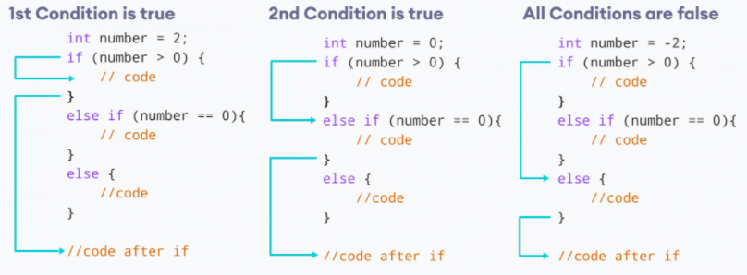
How if...else...else if statement Works?

Slide 26
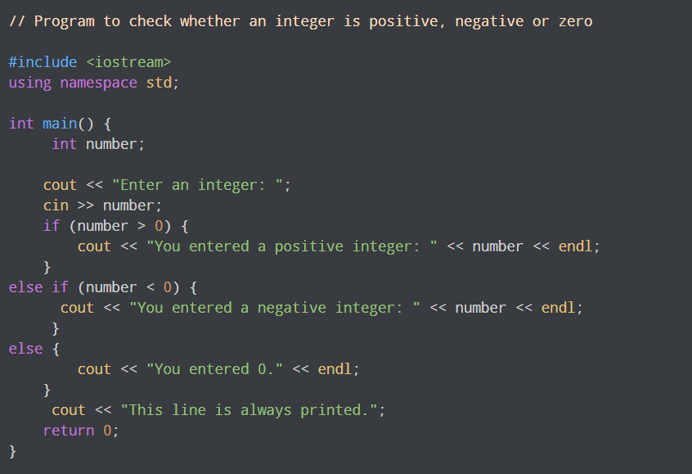
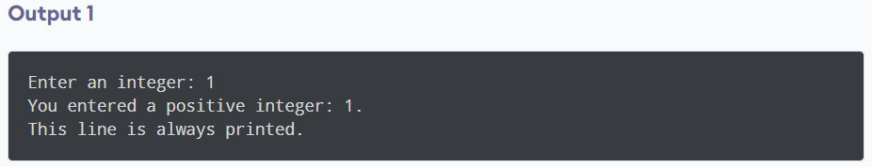
Sample of if...else...else if program

Slide 27
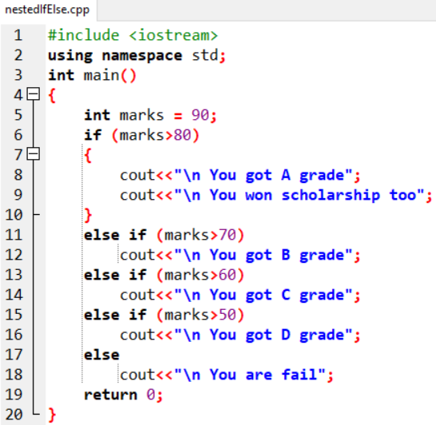

Example: The else...if Construction

Slide 28
Same Or Not?
A. if (month == 1) //Line 1
cout << "January" << endl; //Line 2
else if (month == 2) //Line 3
cout << "February" << endl; //Line 4
else if (month == 3) //Line 5
cout << "March" << endl; //Line 6
else if (month == 4) //Line 7
cout << "April" << endl; //Line 8
else if (month == 5) //Line 9
cout << "May" << endl; //Line 10
else if (month == 6) //Line 11
cout << "June" << endl; //Line 12
b. if (month == 1)
cout << "January" << endl;
if (month == 2)
cout << "February" << endl;
if (month == 3)
cout << "March" << endl;
if (month == 4)
cout << "April" << endl;
if (month == 5)
cout << "May" << endl;
if (month == 6)
cout << "June" << endl;

Slide 29
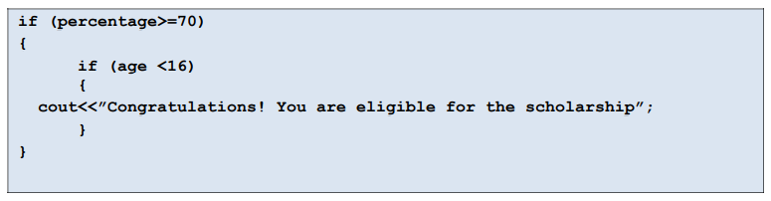
Nested if...else Statement
When we want to make decisions based on more than one conditions then one way of achieving this is using nested-if condition.
Need to use an if statement inside another if statement. This is known as nested if statement.

Slide 30
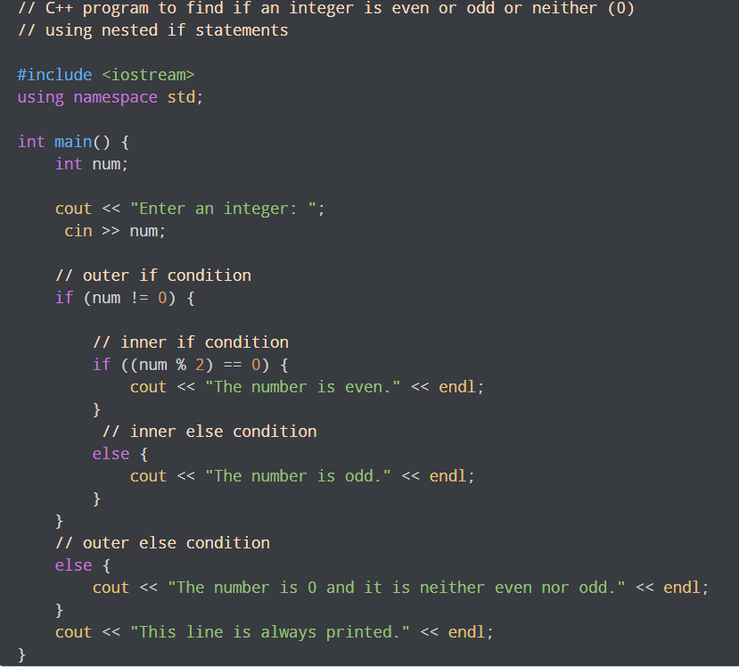
Sample of Nested if program

Slide 31
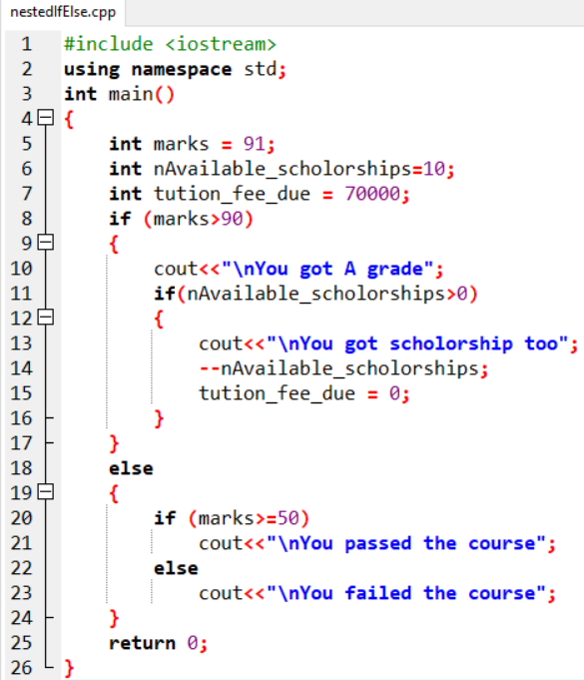

Example: Nested “if...else” Statements

Slide 32
Example: Nested if program
#include <iostream>
using namespace std;
int main()
{
int a, b, c;
cout<<“Enter three numbers, a, b, and c:\n”;
cin >> a >> b >> c;
if( a==b )
if( b==c )
cout << “a, b, and c are the same\n”;
else
cout << “a and b are different\n”;
return 0;
}
if( a==b )
{
if( b==c )
cout << “a, b, and c are the same\n”;
}
else
cout<< “a and b are different\n”;
else
cout << “b and c are different\n”;

Slide 33
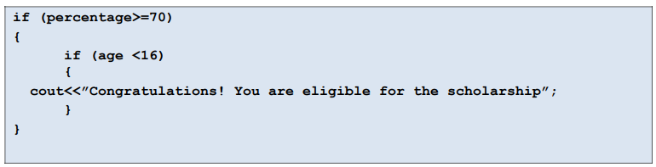

Same or Not??
Nested If
Logical-and (&)

Slide 34
switch statement
Provides a series of alternatives (selections) based on the value of a SINGLE variable
Replaces a series of chained if-else statements
Makes code easier to read

Slide 35
Switch - Syntax
switch (Variable)
{
case <value_1> : statement1;
statement2;
statement3;
break;
case <value_2> : statement1;
statement2;
break;
case <value_3> : statement1;
break;
default: statement1;
statement2;
}
Optional

Slide 36
switch statement (without break)
Suppose ch is 'a’
switch (ch) {
case 'a': cout <<“ ch contains a”;
case 'b': cout <<“ ch contains b”;
case 'c': cout <<“ ch contains c”;
}

Slide 37
switch statement (with break)
Suppose ch is ‘b’
switch (ch) {
case 'a': cout <<“ ch contains a”; break;
case 'b': cout <<“ ch contains b”; break;
case 'c': cout <<“ ch contains c”; break;
}
cout<<“\n End of program…”;

Slide 38
Switch – Example-1
char grade;
cin>>grade;
switch (grade)
{
case ‘A’: tution_fees *= 0.20; break;
case ‘B’: tution_fees *= 0.40; break;
case ‘C’: tution_fees *= 0.60; break;
default: tution_fees *= 1;
}

Slide 39
Switch – Example-2
int day;
cout<<“Enter day number“; cin>>day;
switch (day) {
case 1 :
case 7 : cout << "This is a weekend day";
break;
case 2 :
case 3 :
case 4 :
case 5 :
case 6 : cout << "This is a weekday"; break;
default : cout << "Not a legal day";
}

Slide 40
Switch – Example-3
int n1, n2; char key;
cout<<“\nEnter numbers: “;
cin>>n1>>n2;
cout<<“Enter an arithmetic operator”;
cin>> key;
switch (key)
{
case ‘+’ : cout<<(a+b); break;
case ‘-’ : cout<<(a-b); break;
case ‘*’ : cout<<(a*b); break;
case ‘/’ : cout<<(a/b); break;
default: cout<<“Error: Invalid key…";
}

Slide 41
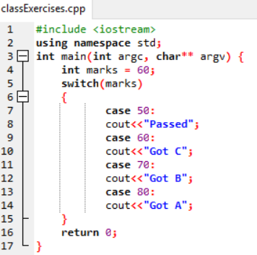

Class Exercise-1
What will be the output of the following code?
int marks = 60;
switch(marks)
{
case 50 : cout<<”Passed”;
case 60 : cout<<”Got C”;
case 70 : cout<<”Got B”;
case 80 : cout<<”Got A”;
}

Slide 42
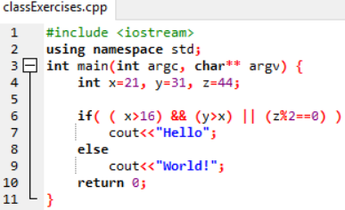

Class Exercise-2
What will be the output of the following code?
int x=21, y=31, z=44;
if( ( x>16) && (y>x) || (z%2==0) )
cout<<“Hello“;
else
cout<<“World!“;

Slide 43
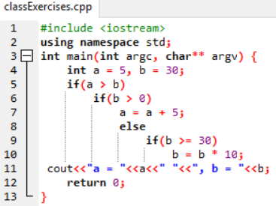

Class Exercise-3
What will be the output of the following code?
int a = 5, b = 30;
if(a > b)
if(b > 0)
a = a + 5;
else
if(b >= 30)
b = b * 10;
cout<<”a=”<<a<<” ”<<”, b=”<<b;

Slide 44
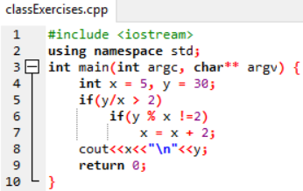

Class Exercise-4
What will be the output of the following code?
int x = 5, y = 30;
if(y/x > 2)
if(y % x !=2)
x = x + 2;
cout<<x<<”\n“<<y;

Slide 45
Class Exercise-5
Write a program that ask the user to enter a number in the range of 1—10.
Use a switch statement and display corresponding Roman Number against each entered decimal value. E.g.,
1 → I
2 → II
3 → III
4 → IV

Slide 46
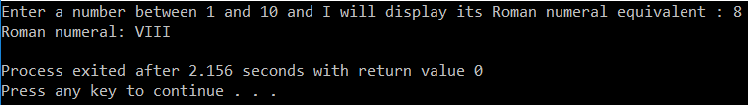
Class Exercise-6
#include <iostream>
using namespace std;
int main(int argc, char** argv) {
int number;
cout << "Enter a number between 1 and 10 and I will display its Roman numeral equivalent : ";
cin >> number;
cout << "Roman numeral: ";
switch (number)
{
case 1:
cout << "I";
break;
case 2:
cout << "II";
break;
case 3:
cout << "III";
break;
case 4:
cout << "IV";
break;
case 5:
cout << "V";
break;
case 6:
cout << "VI";
break;
case 7:
cout << "VII";
break;
case 8:
cout << "VIII";
break;
case 9:
cout << "IX";
break;
case 10:
cout << "X";
break;
default:
cout << "Error!\nYou did not enter a number between 1 and 10";
}
return 0;
}

Slide 47
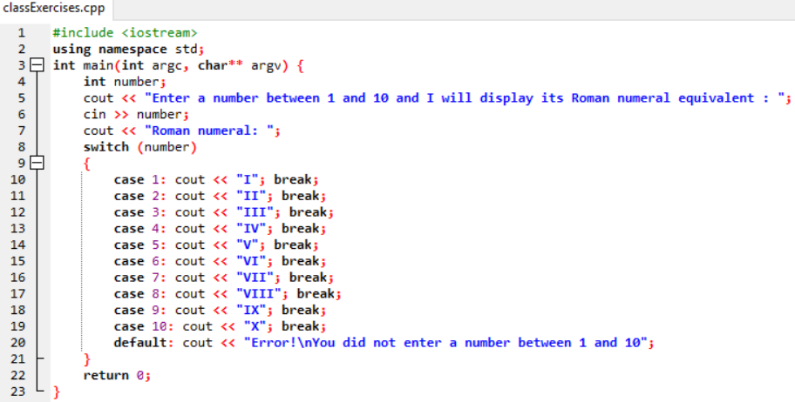
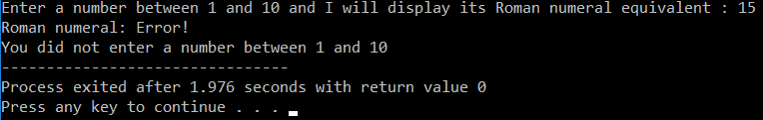
Class Exercise-6

